Slide 1
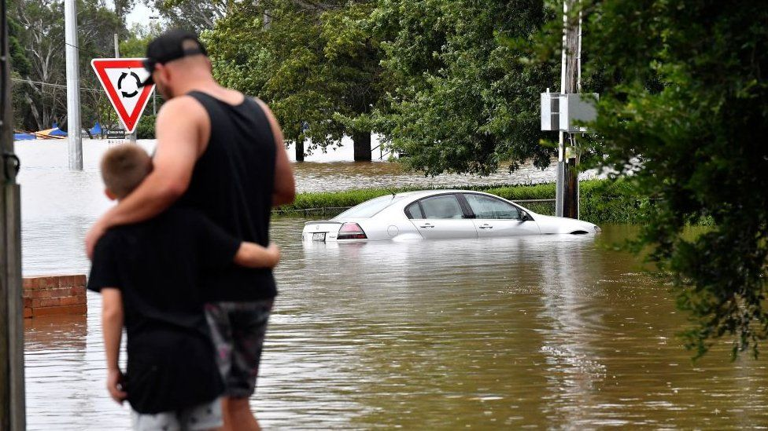
What do you think is happening here?
This is a picture of flooding. This will become more common in the coming decades due to climate change.

Slide 2
Do now activity…
Climate change refers to long-term shifts in temperatures and weather patterns. These shifts may be natural, but since the 1800s, human activities have been the main cause of climate change, primarily due to the burning of fossil fuels (like coal, oil and gas), which produces heat-trapping gases.
Climate change will cause more extreme weather. Effects of climate change include: flooding, food and water shortages, extreme heat, extreme and unusual weather, and economic loss (people becoming poorer).
What does “climate change” mean to you?
Have you heard of it either in school or at home?
Do you know some of the things that climate change will cause?
That’s quite a lot of information to take in. Let’s look at each answer in more detail…

Slide 3
Climate Change Lesson 1: The State of Play
Learning Intention: To understand what climate change is.
Success criteria 1: To understand what is meant by climate change.
Success criteria 2: To understand some of the causes of climate change.
Success criteria 3: To understand some of the effects of climate change.

Slide 4
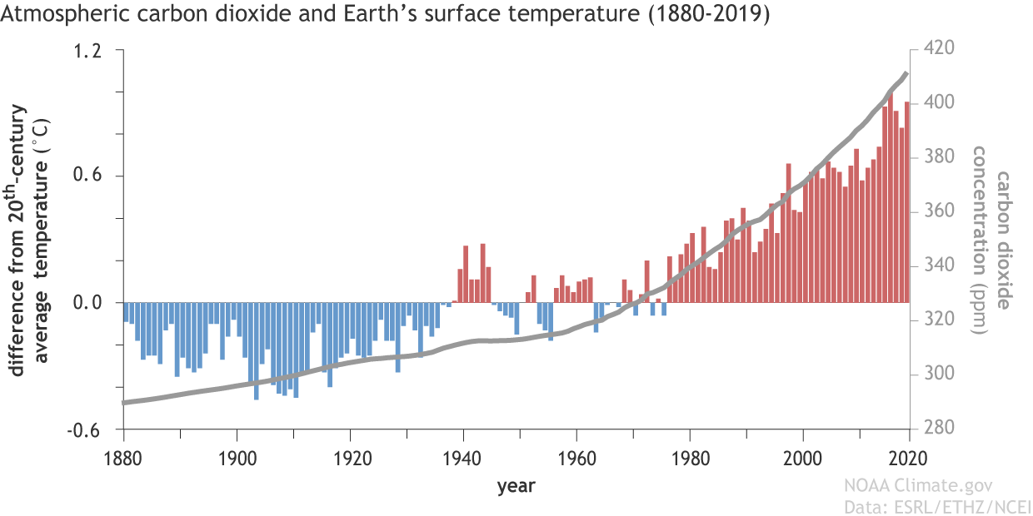
Success criteria 1: To understand what is meant by climate change.
Climate change describes a change in the average conditions — such as temperature and rainfall — in a region over a long period of time. Scientists from all over the world have observed Earth’s surface is warming, and many of the warmest years on record have happened in the past 20 years.
Since the 1800s, human activities have been the main cause of climate change, primarily due to the burning of fossil fuels (like coal, oil and gas), which produces heat-trapping gases.
Climate change will cause more extreme weather. Effects of climate change include: flooding, food and water shortages, extreme heat, extreme and unusual weather, and economic loss (people becoming poorer).
What is the graph showing?
https://www.climate.gov/media/11048

Slide 5
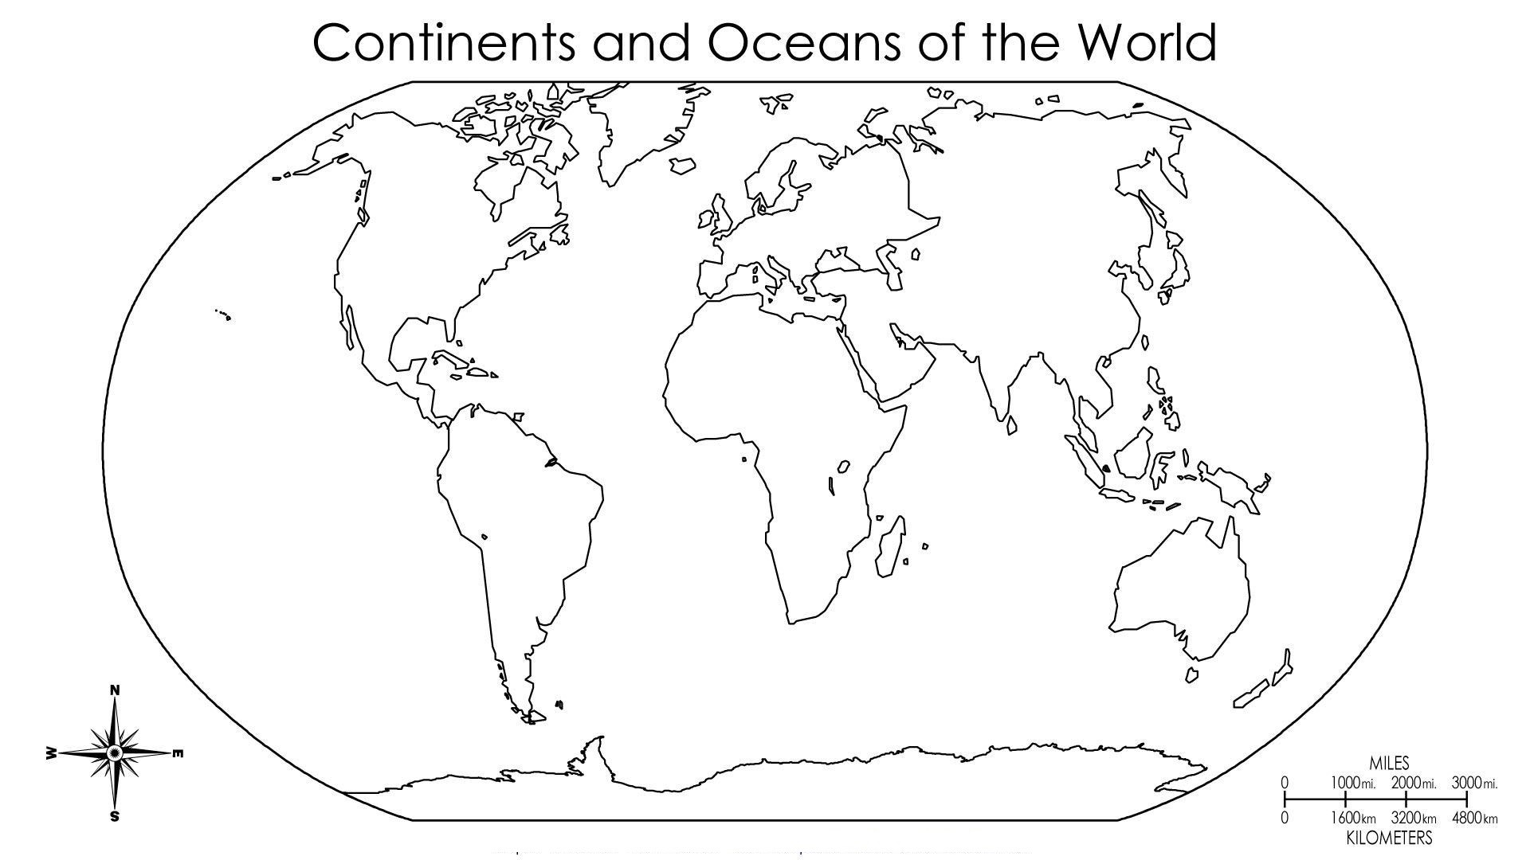
Success criteria 2: To understand some of the causes of climate change.
You now need to fill in your maps.
Norway is one of the world leaders in changing from Petrol/Diesel cars to Electric cars.
Use a ruler and pencil to draw a line to the country/area we are discussing.
Write your notes in pen.
Look at the map opposite for an example.

Slide 6
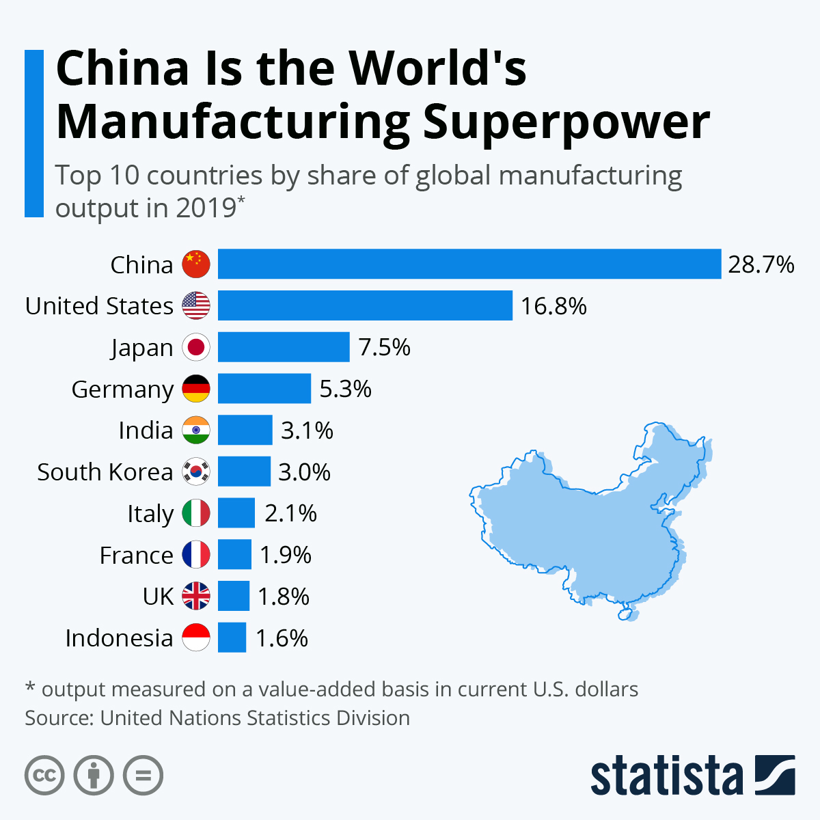
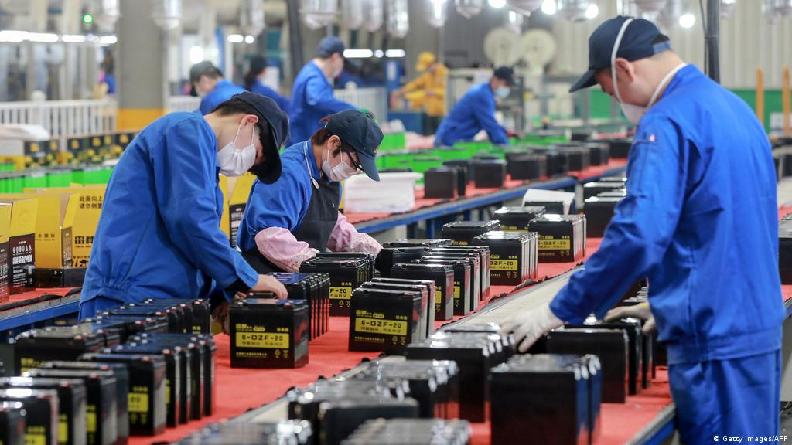
Success criteria 2: To understand some of the causes of climate change.
You now need to fill in your maps.
What is happening in this picture?
This is a factory in China.
China is the biggest manufacturer of products in the world. Producing things requires energy and raw materials, which add to climate change.

Slide 7
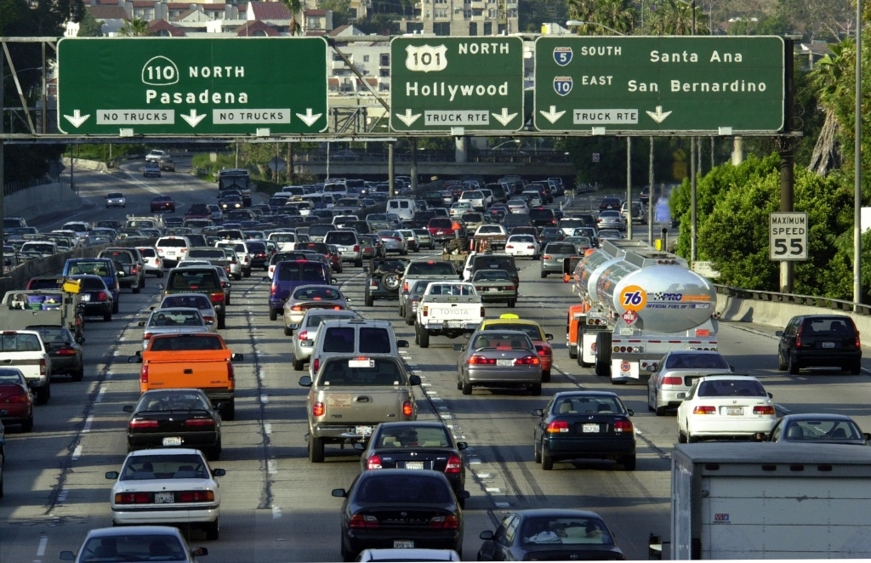
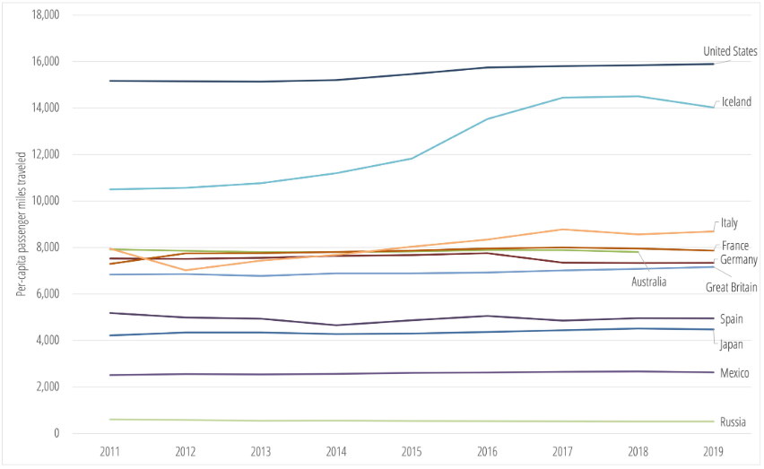
Success criteria 2: To understand some of the causes of climate change.
You now need to fill in your maps.
Where is this?
What is this picture showing?
Why might it be a problem?
This is the United States of America.
It shows traffic on a highway in Los Angeles (LA).
Transport is responsible for around 30% of emissions.
This chart shows the average number of miles a person travels by car, each year. The USA has a figure about twice as high as comparable countries.

Slide 8
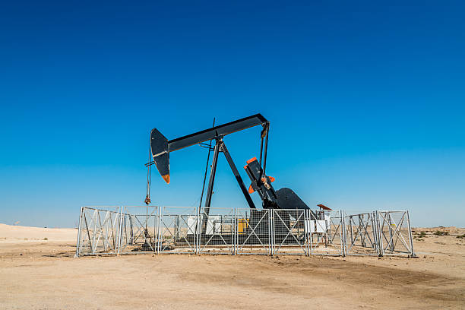
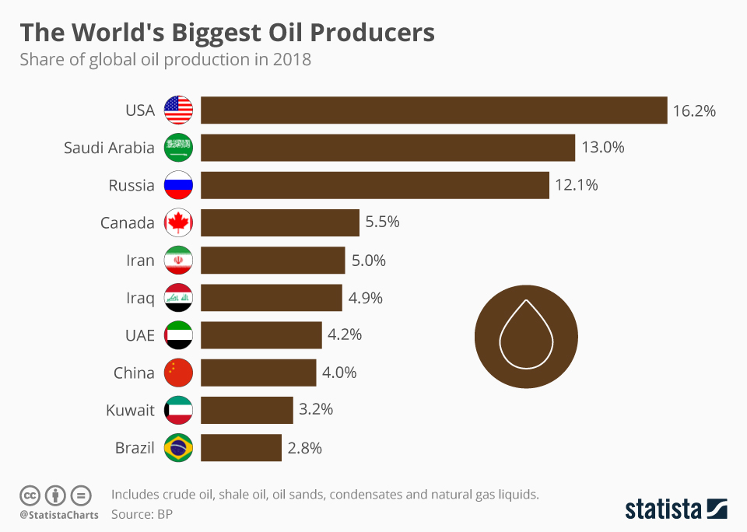
Success criteria 2: To understand some of the causes of climate change.
You now need to fill in your maps.
What is this?
Where might it be in the world?
Why is this a problem?
This is a machine that pumps oil from a well.
This pump is in Saudi Arabia.
Oil and the products it creates like petrol or diesel, are big causes of climate change when they’re burnt.

Slide 9
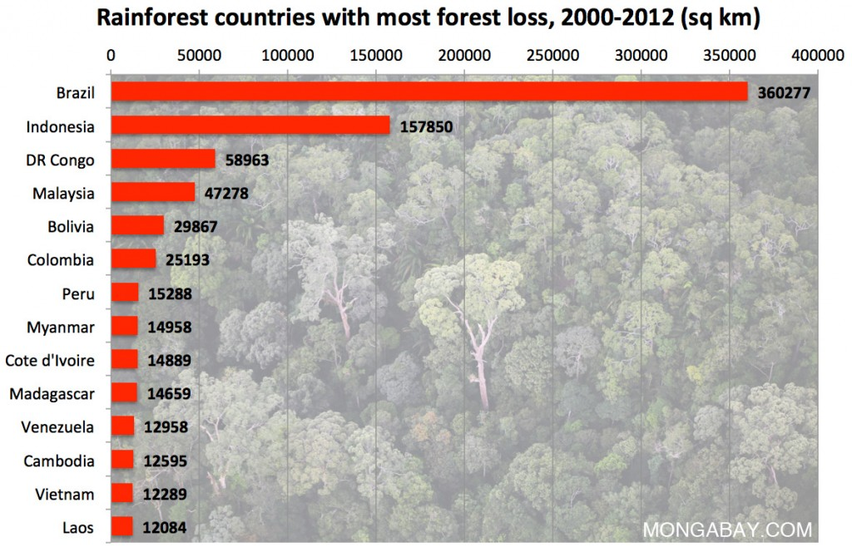
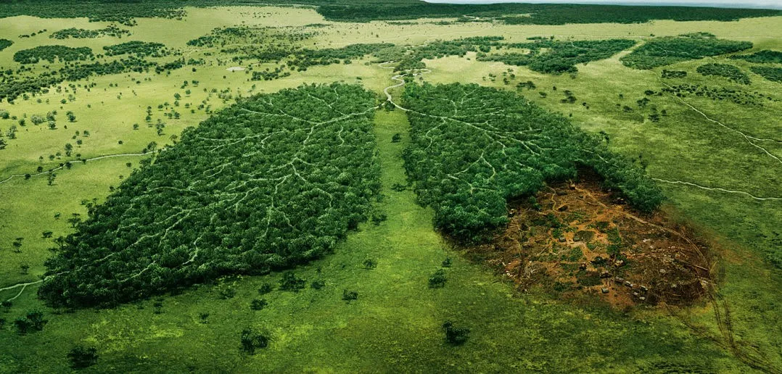
Success criteria 2: To understand some of the causes of climate change.
You now need to fill in your maps.
What is this picture trying to show?
Why are trees so important?
This picture is representing deforestation (cutting trees down).
Trees take in carbon dioxide – a gas that contributes to climate change. If we cut them down, there’s more carbon dioxide in the atmosphere (air).
Brazil has lost a huge amount of rainforest. Between 2000-2012, it lost 360,277 KM².
That’s about the same as 67,326,205 football pitches!

Slide 10
Success criteria 3: To understand some of the effects of climate change.
You now need to fill in your maps, using the information around the room.
Spend 2-3 minutes at each station, recording the information on your map.

Slide 11
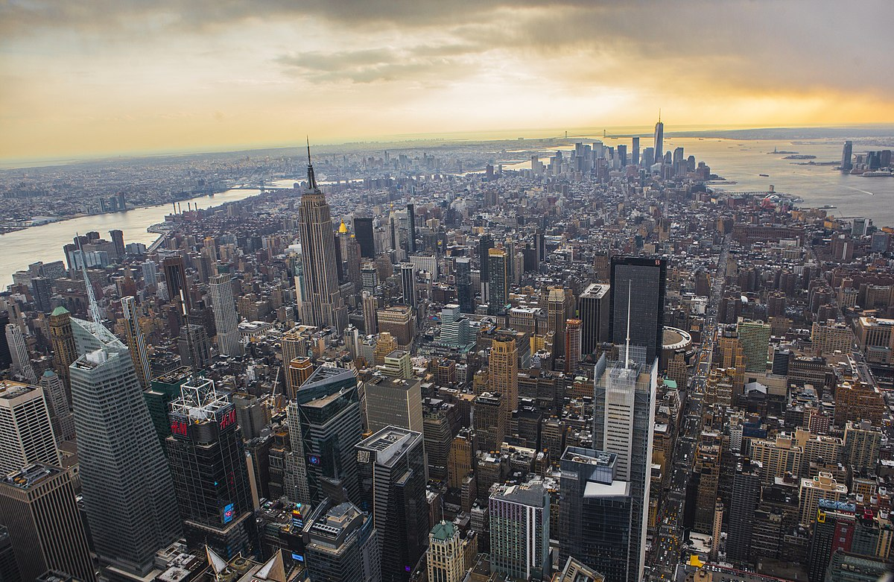
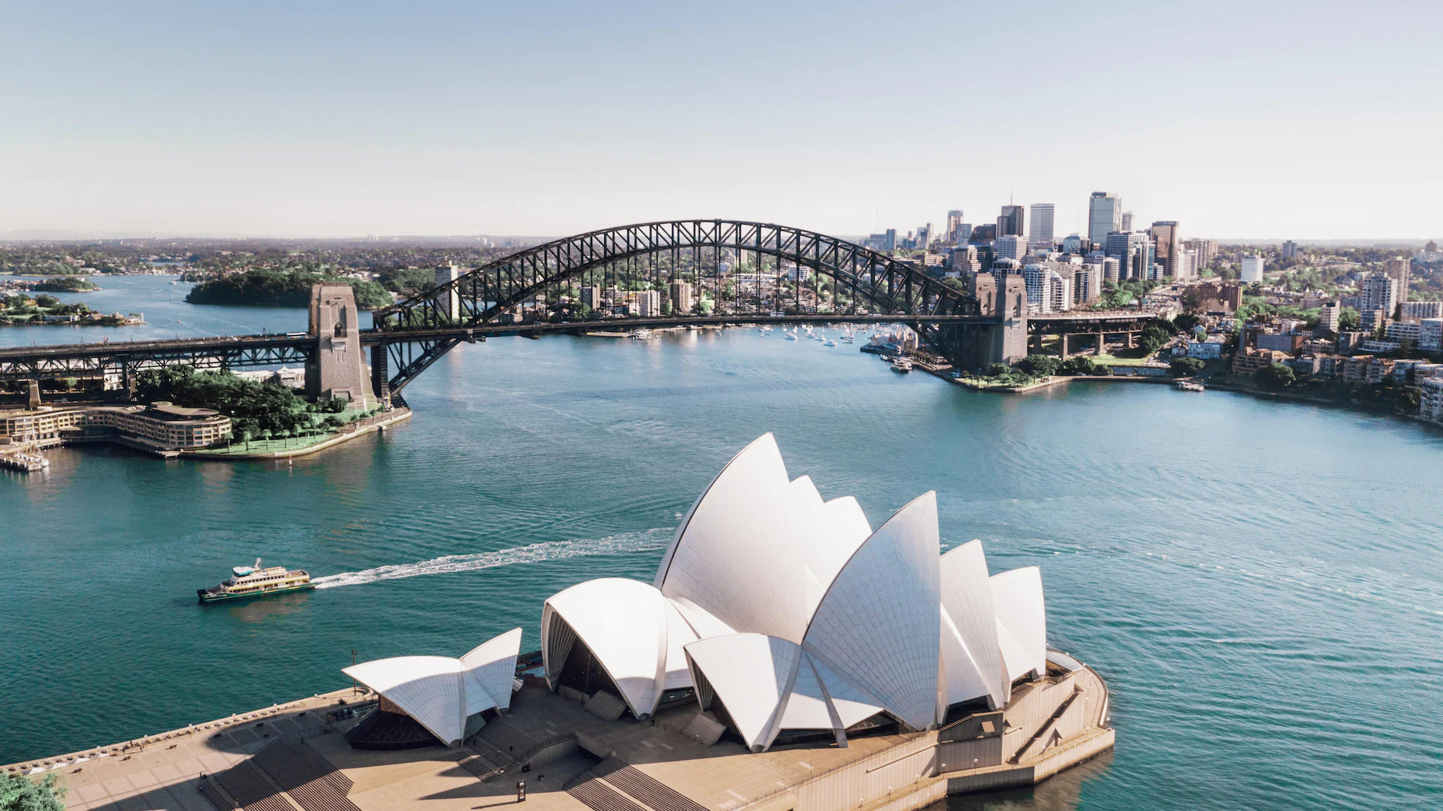
Success criteria 3: To understand some of the effects of climate change.
STATION A
As the world warms up, ice will melt from the north and south poles, causing the sea level to rise. It’s estimated sea levels will rise by between 30cm-80cm by 2100.
While this might sound far into the future and not that much, it could flood many coastal cities, such as New York and Sydney.

Slide 12
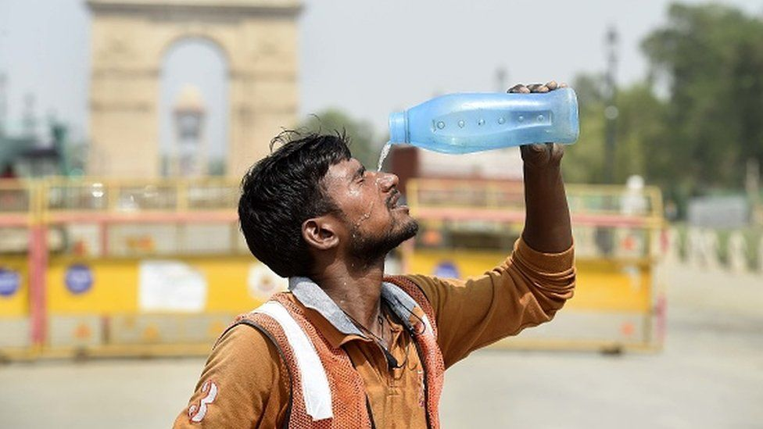
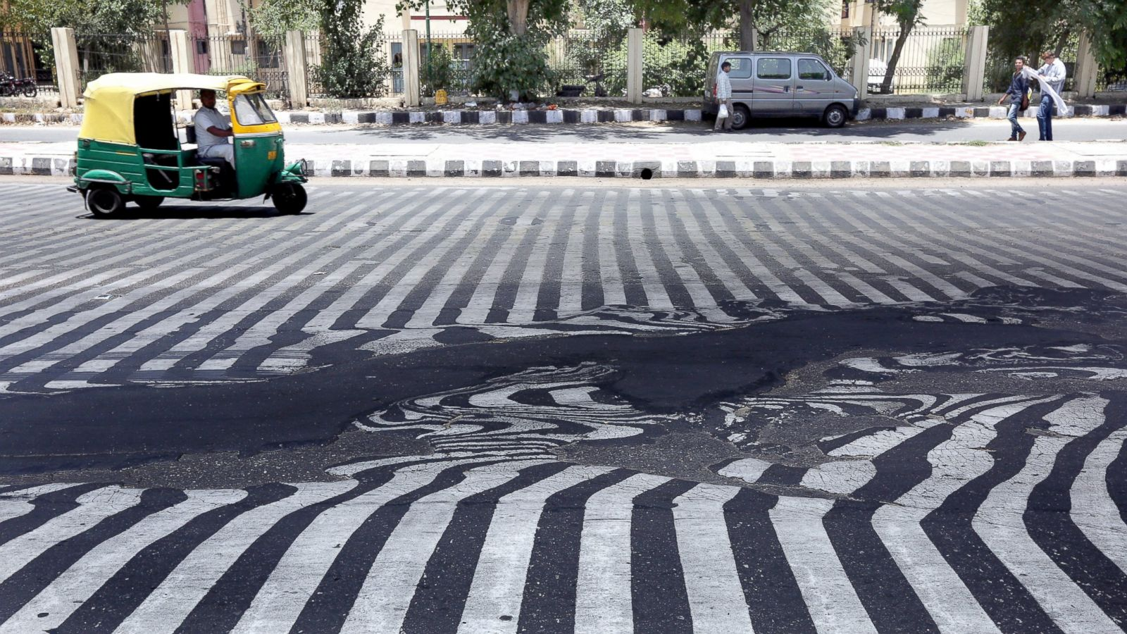
Success criteria 3: To understand some of the effects of climate change.
STATION B
Climate change will cause an increase in average global temperatures and increases the risk of heatwaves.
In some places like India, this could cause extremely high temperatures that cause a risk to human life for the young, old and sick.
Between March and May 2022, there were 5 heatwaves in India, with temperatures reaching as high as 49.2ºc.
Temperatures were so hot that roads started to melt.

Slide 13
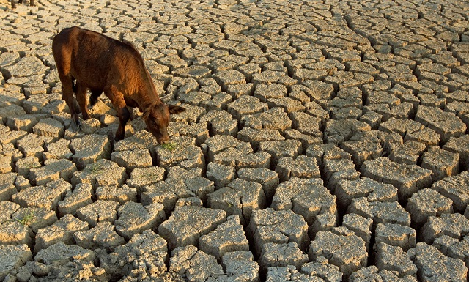
Success criteria 3: To understand some of the effects of climate change.
STATION C
With increased global temperatures and reduced rainfall, droughts (an extreme lack of water) will also become more common.
In 2018, Kenya experienced a drought that not only lead to water shortages, but also a million people on the brink of famine as crops didn’t grow due to lack of water.
Land dries out and crops don’t grow.

Slide 14
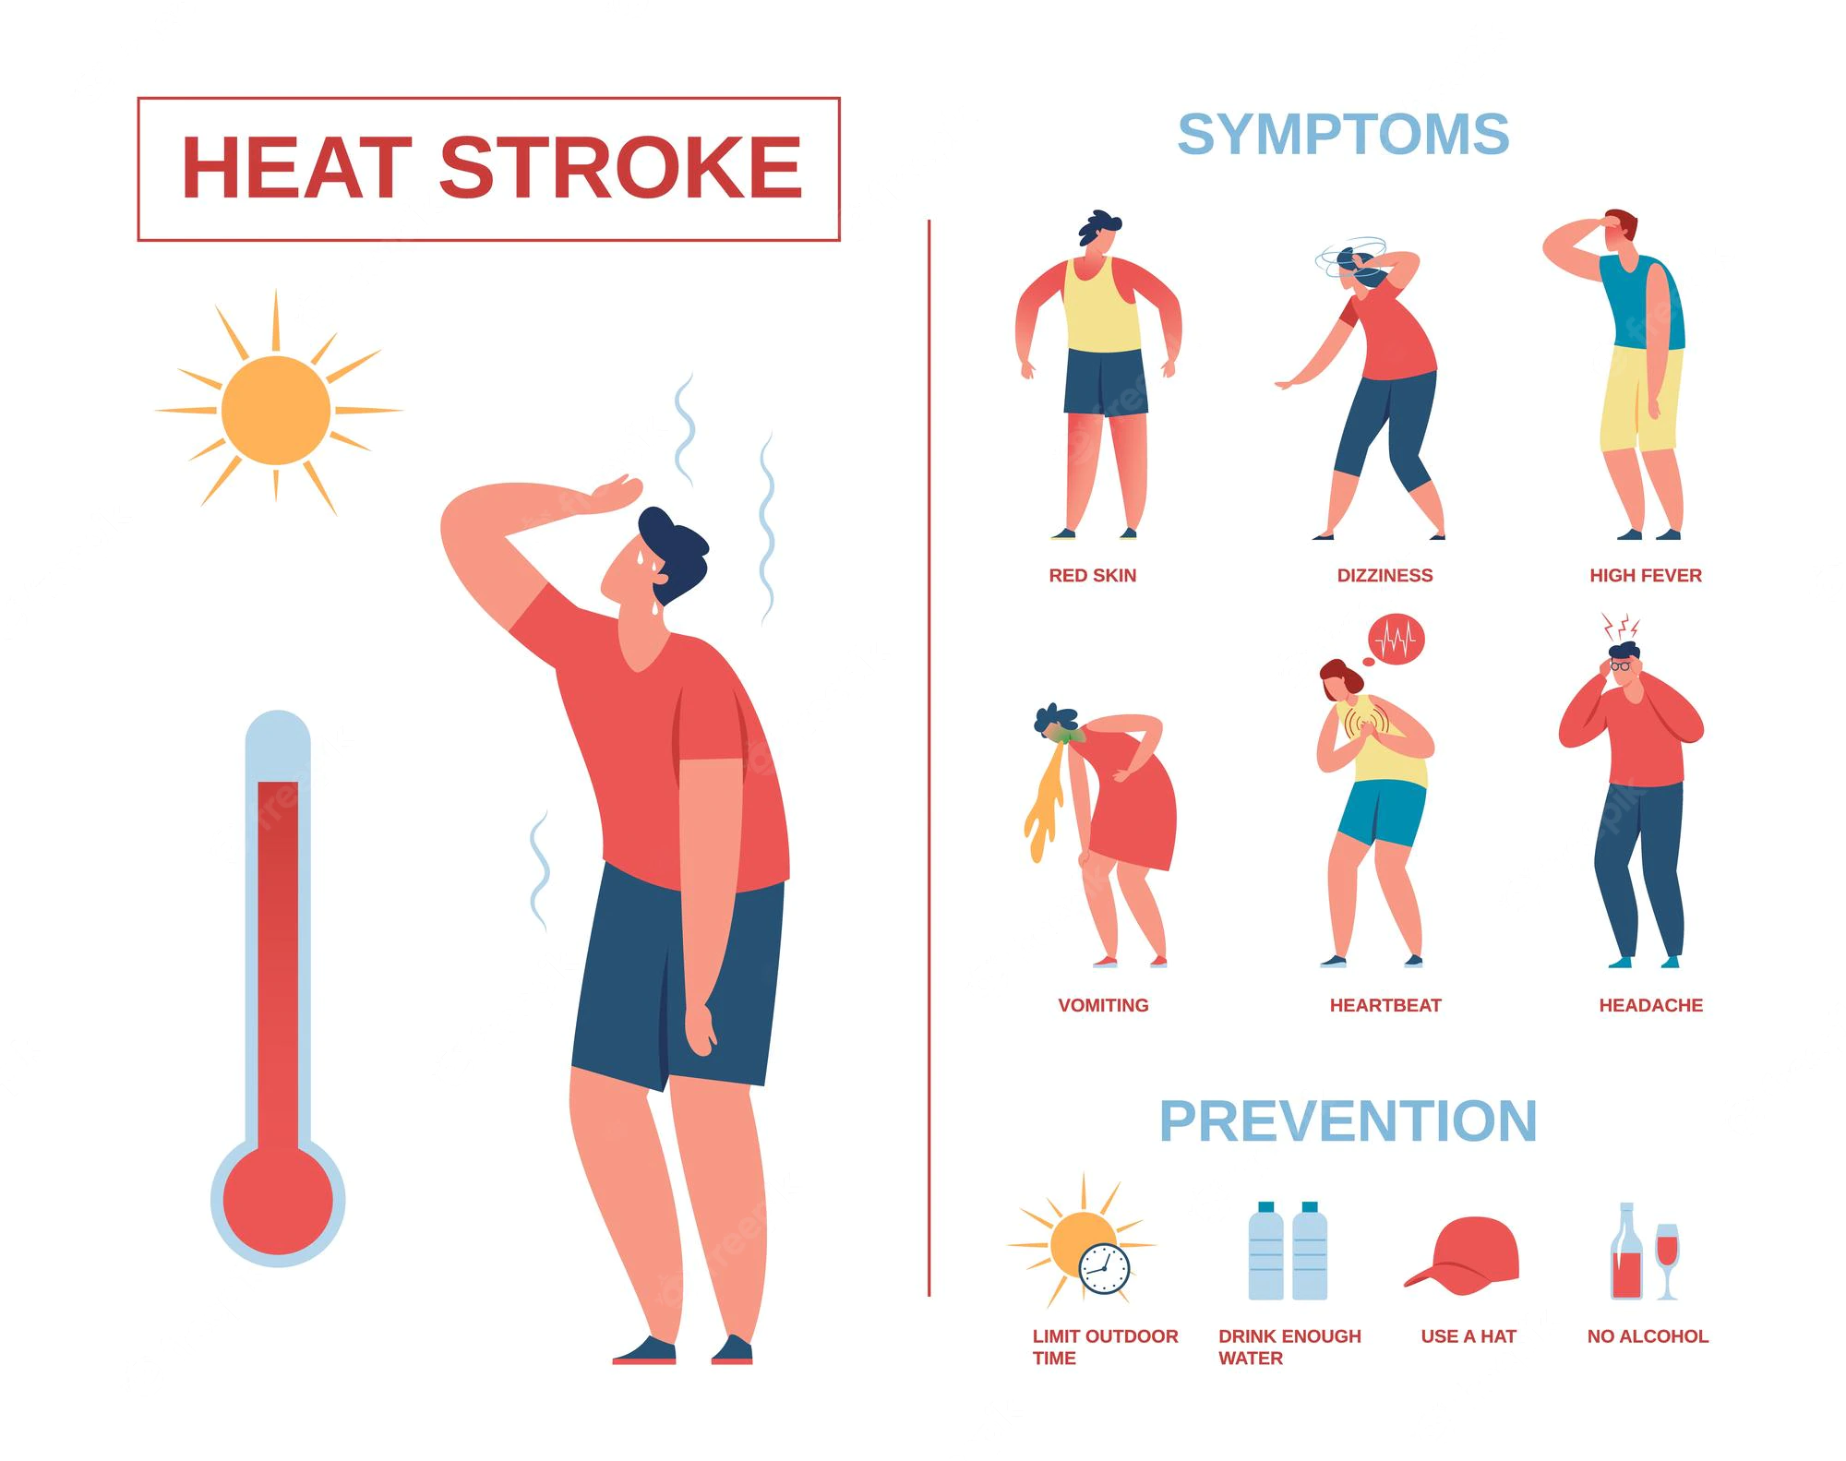
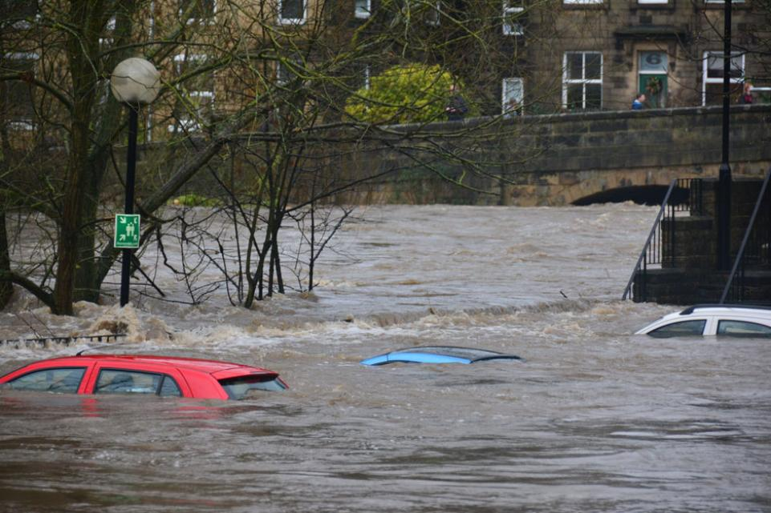
Success criteria 3: To understand some of the effects of climate change.
STATION D
Climate change will affect the UK too.
We are likely to experience more extreme weather like flooding and heatwaves.

Slide 15
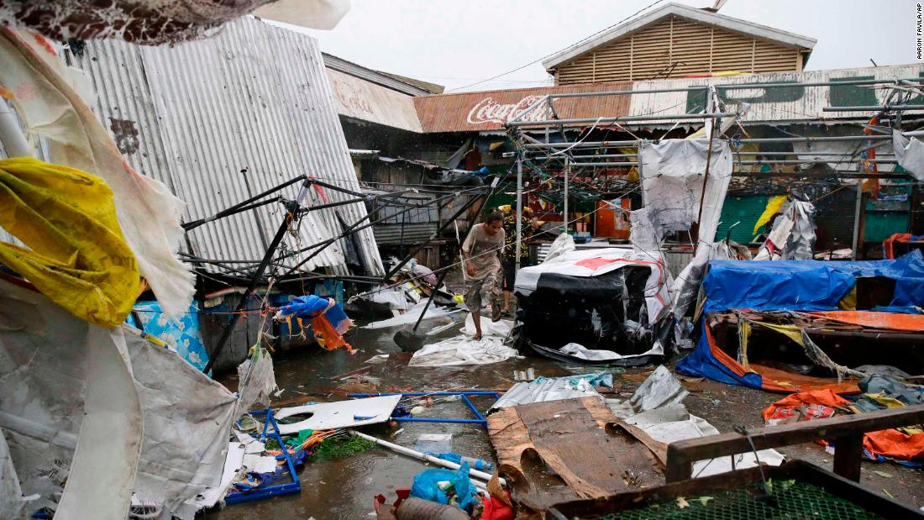
Success criteria 3: To understand some of the effects of climate change.
STATION E
With higher temperatures in the sea, typhoons and hurricanes are likely to be more powerful and destructive.
In 2018, Typhoon Mangkhut's passage through the Philippines affected more than 250,000 people across the country.
Homes and businesses are destroyed, along with key infrastructure being damaged.

Slide 16
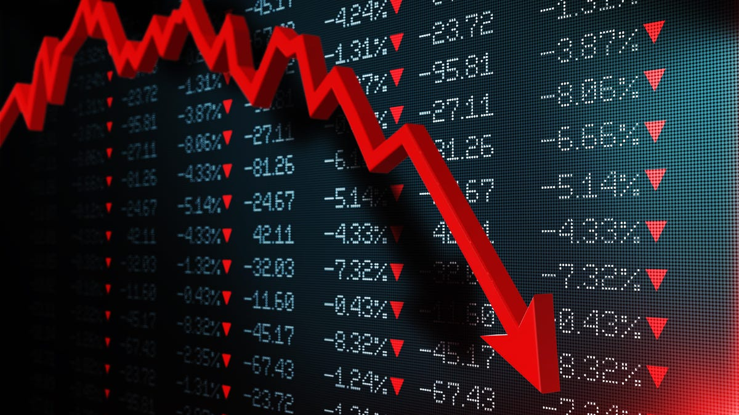
Success criteria 3: To understand some of the effects of climate change.
STATION F
Climate change will affect the entire world economy. Damage from extreme weather/climate will cost money to repair and stop people from making money while they’re being repaired or seeking shelter.
The world could be 11% poorer if climate change continues at it’s current rate.

Slide 17
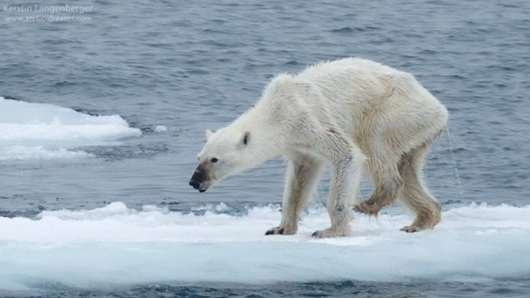
Success criteria 3: To understand some of the effects of climate change.
STATION G
Climate change will affect wildlife.
One famous example is polar bears. As ice melts, their home is effectively destroyed. They can swim, but can’t hunt in the water, so starve.
https://www.zmescience.com/ecology/polar-bear-swim-25042016/

Slide 18
Look at the maps you’ve filled in and discuss any patterns you can see with your partner?
-Which areas are responsible for climate change?
-Which areas are going to be affected by climate change?
Climate change is caused by lots of countries around the world. There isn’t one country to blame.
Climate change will affect all countries around the world.

